Slide 1

Predicting
Crime Category
in San Francisco
MSAN 621 Final Project
Jinxin Ma, Juan Pablo Oberhauser, Jennifer Zhu
December 8, 2016
Notes:
10 min presentation plus 3 min Q&A
11:30am

Slide 2
Outline
Introduction
Data
Features
Models
Conclusion

Slide 3
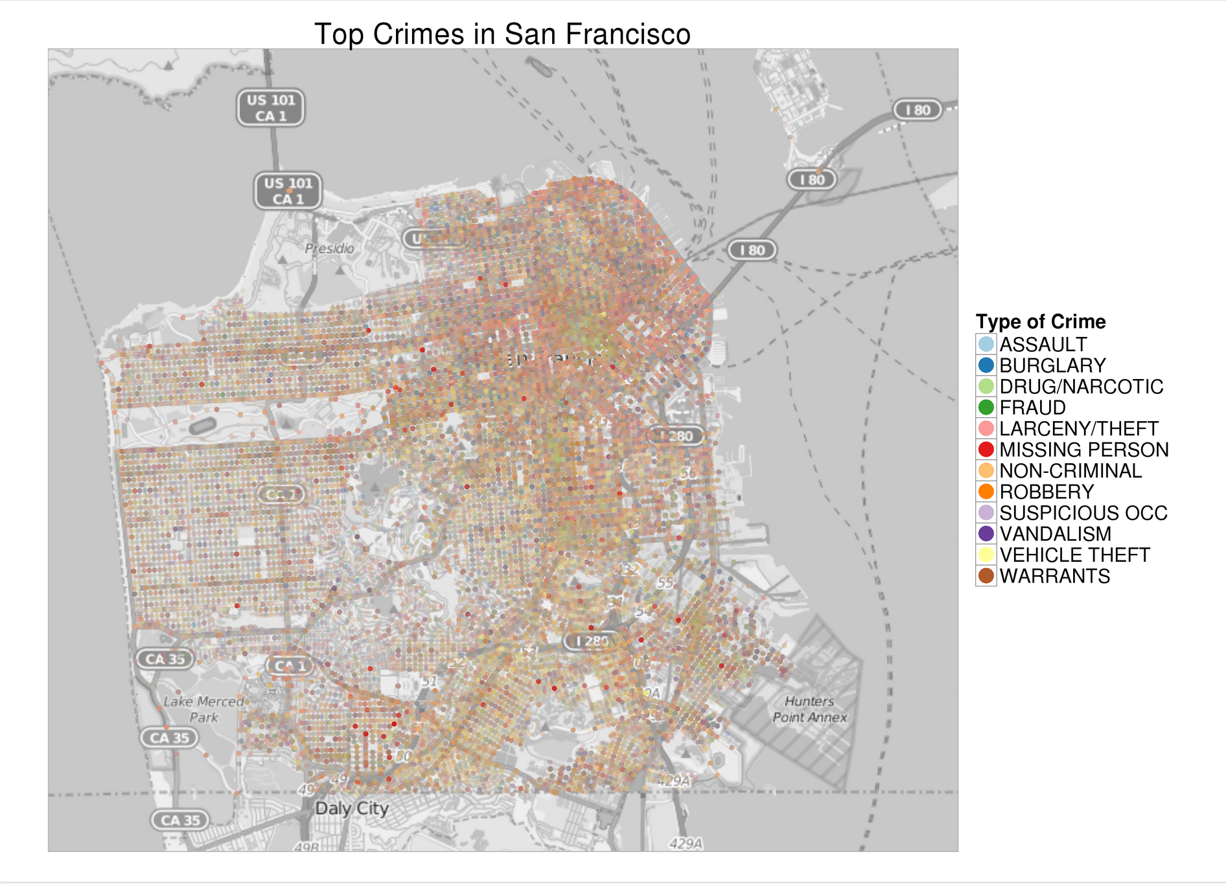
Introduction

Slide 4
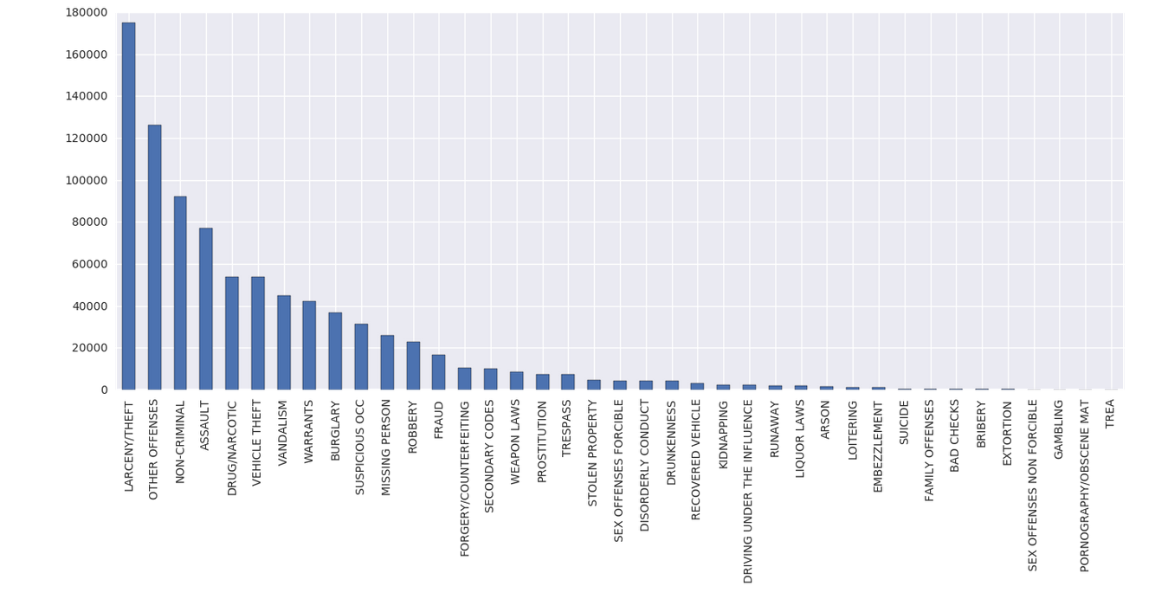
Data
SFPD crime incident reporting system data
1/1/2003 to 11/1/2015
30 + categories of crimes

Slide 5
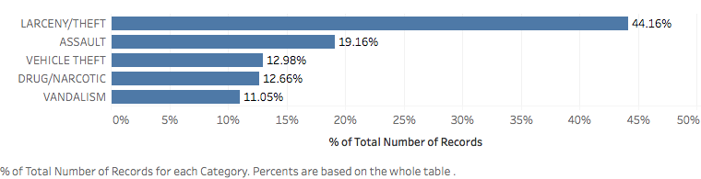
Simplified Version of
Data

Slide 6
Features:
Temporal
day, month, year, and hour
weekend or weekday?
day of the week

Slide 7
Features:
Geospatial
District In the corner or not?
Latitude and longitude coordinates
Polar and radial coordinates
Notes:
Too busy?

Slide 8
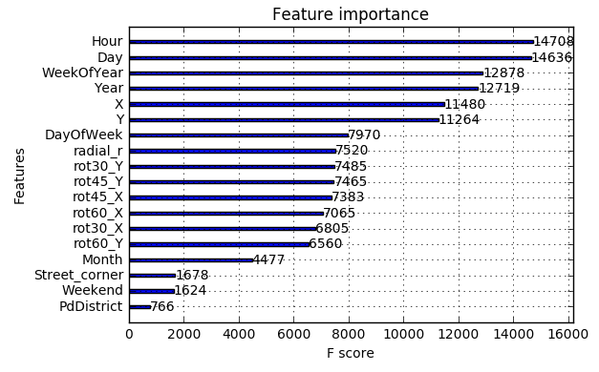
Features:
Summary

Slide 9
Models:
Extreme Gradient Boosting

Slide 10
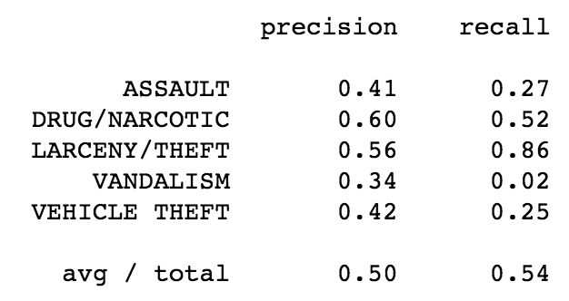
Models:
Evaluation

Slide 11
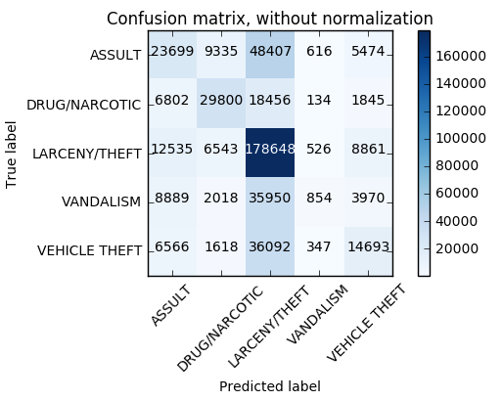
Models:
Evaluation

Slide 12
Conclusion

Slide 13
Supplementary
Slides
MSAN 621 Final Project
Jinxin Ma, Juan Pablo Oberhauser, Jennifer Zhu
December 8, 2016
Notes:
For preparation and Q&A

Slide 14
Problem
SFPD crime incident reporting system data
1/1/2003 to 11/1/2015
30 + categories

Slide 15
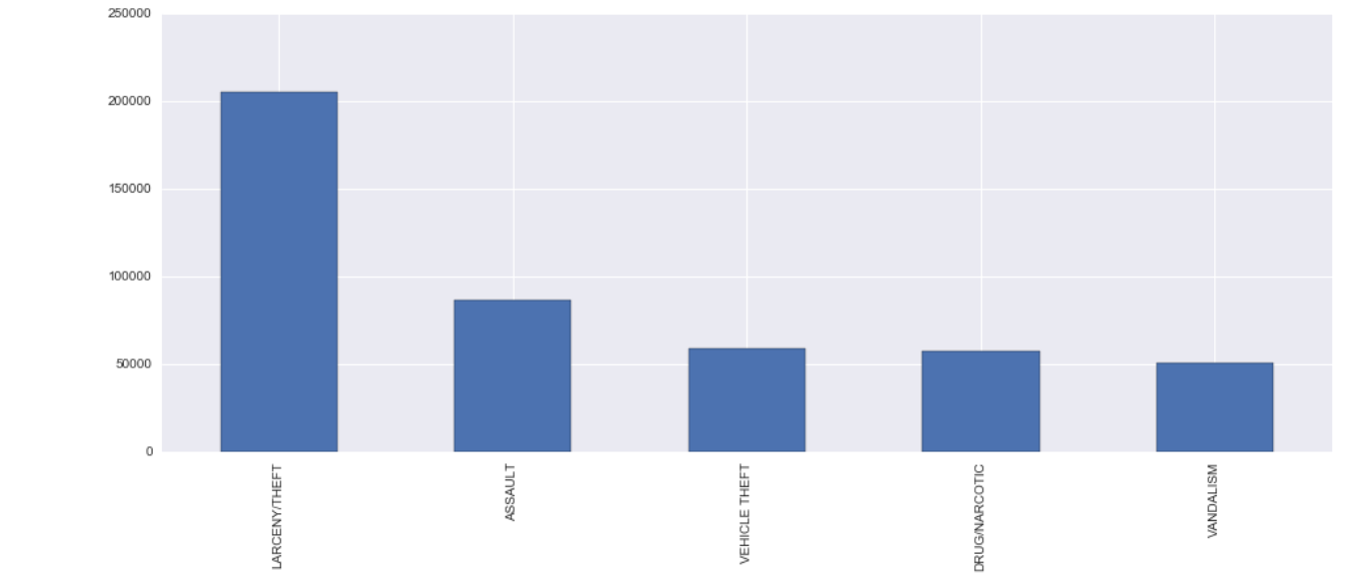
Simplified Version

Slide 16
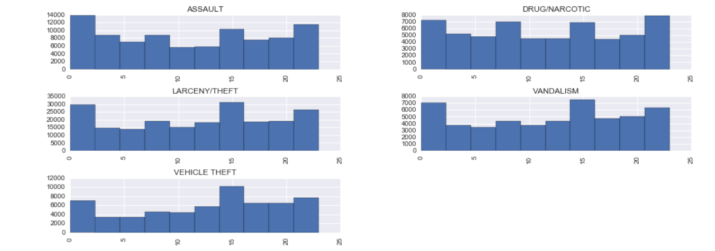
Features:
Hour

Slide 17
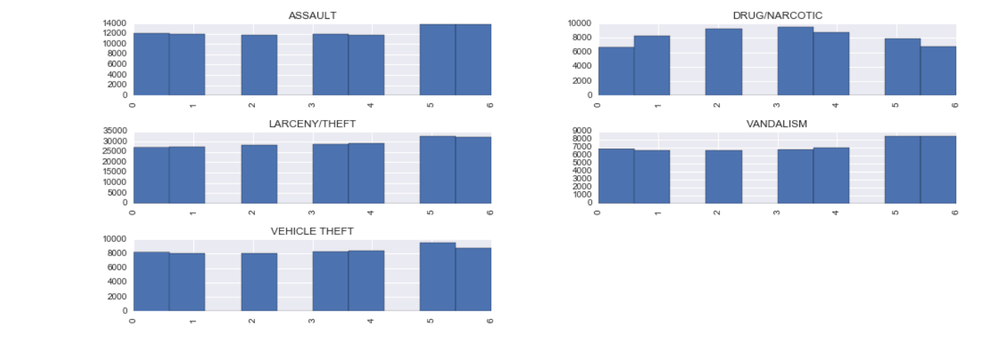
Features: DayofWeek

Slide 18
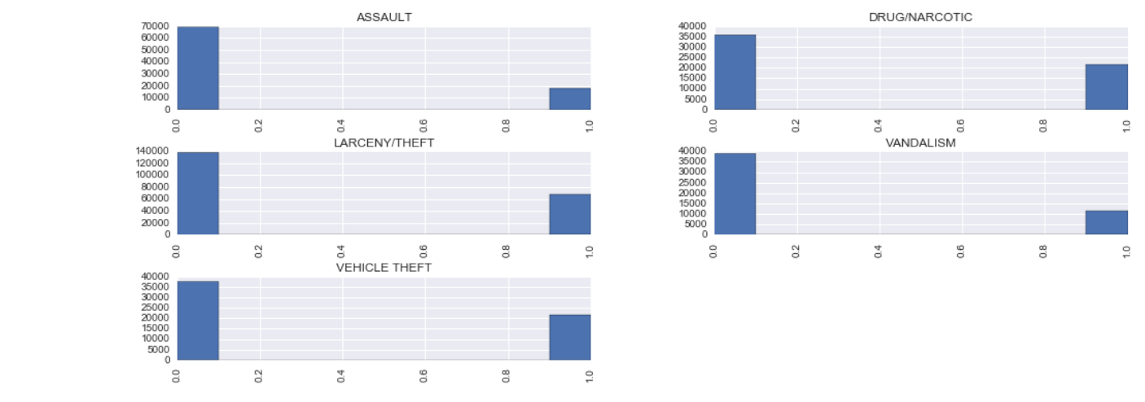
Features:
Street Corner

